Slide 1



Data Science and Machine Learning Capstone Project
Stephen Malcolm
05/ 06/ 2023

Slide 2




Outline
Executive Summary
Introduction
Methodology
Results
EDA with Visualization
EDA with SQL
Interactive Maps with Folium
Interactive Maps with Plotly
Machine Learning Prediction
Conclusion
Appendix

Slide 3



Executive Summary
Summary of methodologies
Data collection via API & Web Scraping
Exploratory Data Analysis (EDA) with Data Visualization
EDA with SQL
Building an Interactive Map with Folium
Building a Dashboard with Plotly Dash
Predictive Analysis (Classification)
Summary of all results
EDA results
Interactive maps and dashboard
Predictive results

Slide 4
Introduction
Background
SpaceX is the first private company to develop a liquid-propellent rocket that has reached orbit; to launch, orbit, and recover a spacecraft; to send a spacecraft to the International Space Station; and to send astronauts to orbit and to the International Space Station. It is also the first organization of any type to achieve a vertical propulsive landing of an orbital rocket booster and the first to reuse such a booster. SpaceX's Falcon 9 rockets have landed and re-flown more than 150 times [1].
Objective
We will predict if the Falcon 9 first stage will land successfully. SpaceX advertises Falcon 9 rocket launches on its website, with a cost of 62 million dollars; other providers cost upward of 165 million dollars each, much of the savings is because SpaceX can reuse the first stage. Therefore if we can determine if the first stage will land, we can determine the cost of a launch. This information can be used if an alternate company wants to bid against SpaceX for a rocket launch.
Questions
How do variables such as payload mass, launch site, number of flights, and orbits affect the success of the first stage landing?
Does the rate of successful landings increase over time?
What is the best model that can be used for predicting a successful landing?

Slide 5

Methodology

Slide 6
Methodology - Steps
Data Collection:
Using SpaceX Rest API
Using web scraping from Wikipedia
Data Wrangling:
Filter data, handle missing values and apply one hot encoding (to prepare data for analysis and modelling)
EDA:
Perform EDA with visualization and SQL
Perform interactive visual analytics using Folium and
Plotly Dash
Build Model:
To predict landing outcomes using classification models. Tune and evaluate for model optimization

Slide 7
Data Collection – API
Steps
Request data from SpaceX API (rocket launch data)
Decode response using .json() and convert to a dataframe using .jason_normalize()
Request information about the launches from SpaceX API using custom functions
Create dictionary from data
Create dataframe from the dictionary
Filter dataframe to contain only Falcon 9 launches
Replace missing values of Payload Mass with calculated.mean()
Export data to csv file

Slide 8
Data Collection – Web Scraping
Steps
Request data from Wikipedia (Falcon 9 launch data)
Create BeautifulSoup (webscraping library) object from HTML response
Extract column names from HTML table header
Collect data from parsing HTML tables
Create dictionary from the data
Create dataframe from the dictionary
Export data to csv file

Slide 9
Data Wrangling – Part 1
Calculate number of launches for each site
Calculate the number occurrence of each object
Calculate the number and occurrences of mission outcome per orbit type
Create landing outcome column (target variable/ 0 or 1)
Export data to csv file

Slide 10
Data Wrangling – Part 2
In the dataset, there are varied cases where the booster has successful and unsuccessful landings.
Examples of Mission Outcomes:
True Ocean, True RTLS, True ASDS means the mission/ landing was successful (i.e. landed in specific region of Ocean, landed to a ground pad and landed to a drone ship respectively )
False Ocean, False RTLS, False ASDS means the mission/ landing was unsuccessful (i.e. landed in specific region of Ocean, landed to a ground pad and landed to a drone ship respectively )
Convert these mission outcomes into Training Labels:
String variables require to be transformed into categorical variables, where 1 means successful landing of booster and 0 means an unsuccessful landing

Slide 11
EDA with Data Visualization
Scatter Plots - normally used to observe and visually display the relationship/ correlation between variables
Flight Number v Payload Mass
Flight Number v Launch Site
Payload Mass v Launch Site
Orbit Type v Flight Number
Payload Mass v Orbit Type
Orbit Type v Payload Mass
Bar Charts - useful to compare different categorical or discrete variables. Easy to understand relations between variables
Success Rate v Orbit Type
Line Chart - A line chart supports monitoring behaviour in a set of data. These charts are useful for tracking change over time
Success Rate v Year

Slide 12
EDA with SQL
Performed SQL queries to retrieve data from dataset, in IBM cloud database
Displaying:
Names of the unique launch sites in the space mission
5 records where launch sites begin with string, ‘CCA’
Total Payload Mass carried by boosters launched by NASA (CRS)
Average Payload Mass carried by the booster version F9 v1.1
Listing:
Date when the first successful landing outcome in the drone ship was achieved
Names of the boosters which have success in the ground pad and have payload mass greater than 4000, but less than 6000kg
Total number of of successful and failure mission outcomes
Names of the booster versions which have carried the maximum payload mass (using subquery)
Successful landing outcomes in ground pad, their booster versions and launch site names for the month in Year 2017
Count of successful landing outcomes between 04-06-2010 and 20-03-2017 in descending order

Slide 13
Build an Interactive Map with Folium
Markers to Indicate Launch Sites
Blue circle and pop up/ text label created, to indicate NASA Johnson Space Center’s coordinates as a start location
More markers with same features created for all Launch Sites, using their coordinates to show geographical locations and proximity to equator and coast line
Markers of Launch Outcomes
Markers of successful (green) and failed (red) launches implemented, using Marker Cluster to identify which launch sites have high success rates
Distances Between a Launch Site to Proximities
Colored lines were added to to show distances between launch site, KSC LC-39A (our example) and it’s proximity to nearest coastline, railway, highway and city

Slide 14
Build a Dashboard with Plotly Dash
Dropdown list with Launch Sites
Allows user to select launch site or all launch sites
Pie Chart Showing Successful Launches (All Sites/ Specific Sites)
Shows total successful launches count for all sites and the Success v Failed counts for the site, using dropdown component
Slider of Payload Mass Range
Allows user to select payload mass range
Scatter Chart Showing Payload Mass v Success Rate by Booster Version
Allows user to view the relationship/ correlation between Payload Mass and Launch Success

Slide 15
Predictive Analytics (Classification)
Data Pre-Processing
Import and load dataset
Create NumPy array from Class column
Standardize data
Split data into training and test sets
Model Preparation and Evaluation
Create a GridSearchCV object, for parameter optimization
Apply GridSearch CV on various ML algorithms, to find best parameters for each model
Logistic Regression
Support Vector Machine
Decision Tree
K-Nearest Neighbor
Calculate the accuracy on the test data using the .score method
Assess the confusion matrix for all models
Find the model/ method that performs best. Take other evaluation methods into consideration

Slide 16
Results

Slide 17
Results - Summary
EDA results
Interactive analytics demo in screenshots
Predictive analysis results

Slide 18
EDA with Visualization

Slide 19
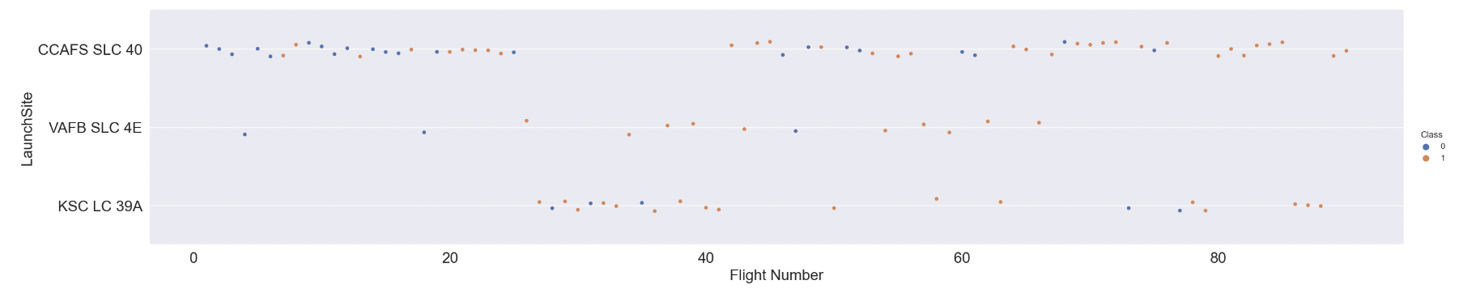
Flight Number v Launch Site
Inferences (Note; blue=failed launch and orange=successful launch):
The earliest flights all failed, whilst the latest flights all succeeded
Around half of all launches were from the CCAFS SLC 40 launch site
VAFB SLC 4E and KSC LC 39A have higher success rates
We finally infer that for each site, the success rate increases over time (later flight numbers)

Slide 20
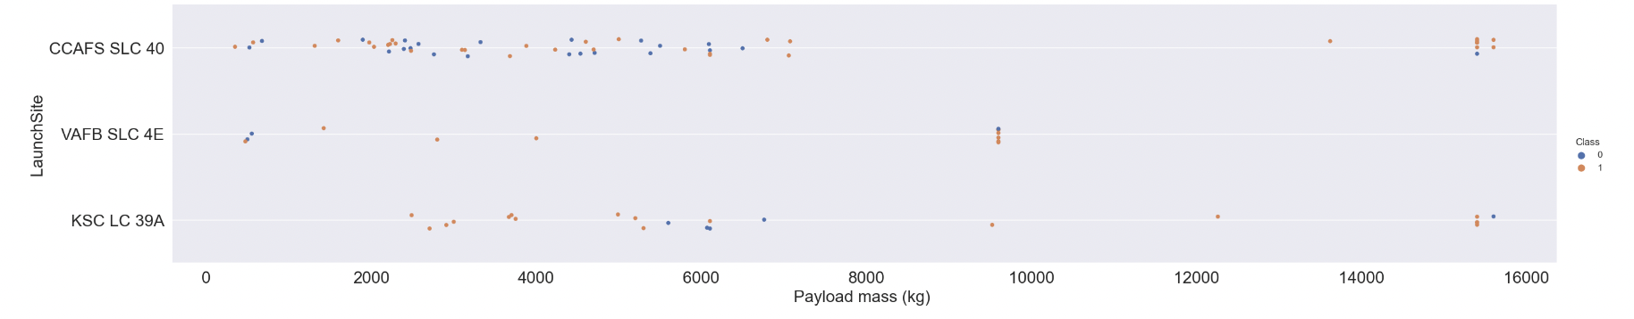
Payload v Launch Site
Inferences (Note; blue=failed launch and orange=successful launch):
The majority of launches with payload mass over 7000kg were successful
KSC LC 39A has a 100% success rate for launches less than 5,500kg
VAFB SKC 4E has not launched anything greater than 10,000kg
Our analysis has led us to a significant inference regarding the impact of payload mass on successful
landings, depending on the launch site. It appears that a heavier payload mass may be a crucial factor to
consider for a successful landing. However, it's important to note that there is a potential risk of failure if
the payload mass exceeds a certain threshold. When the payload mass becomes excessively heavy,
it can potentially jeopardize the landing outcome.

Slide 21
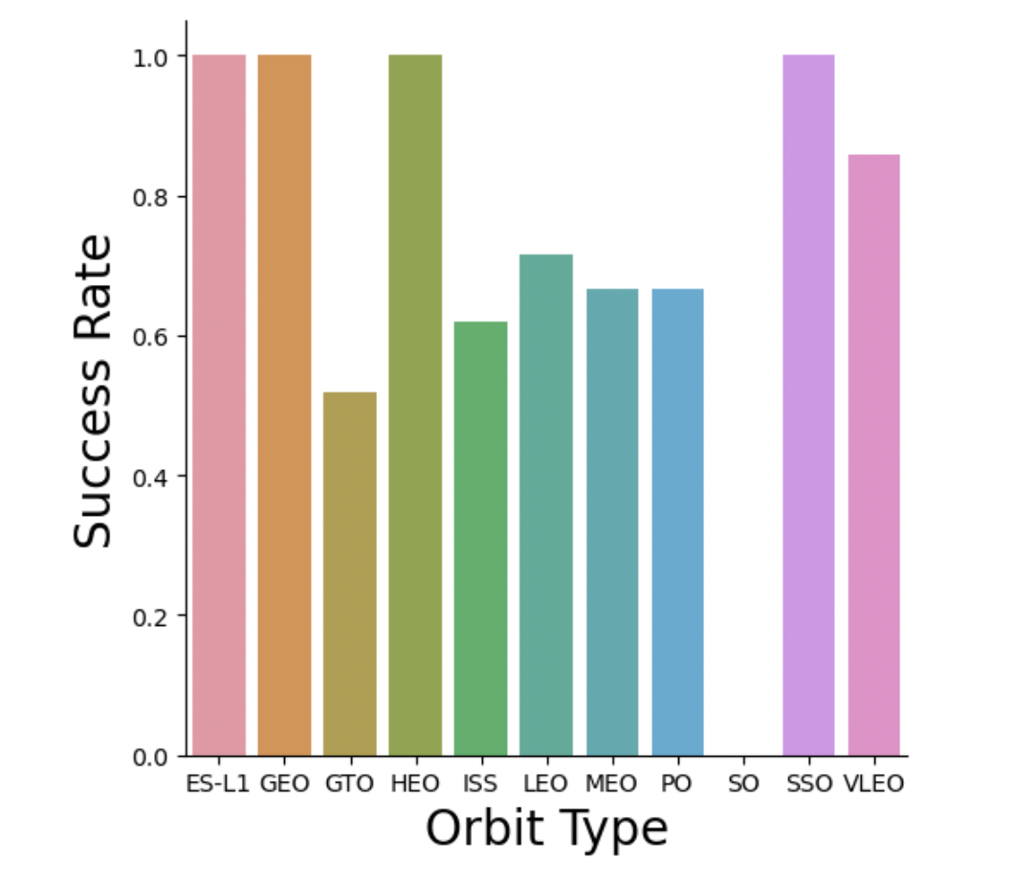
Success Rate v Orbit Type
Inferences:
Orbit types with 100% success rate; ES-L1, GEO, HEO and SSO
Orbit types with success rate between 50% and 85%; GTO, ISS, LEO, MEO and PO
Orbit types with 0% success rate; SO

Slide 22
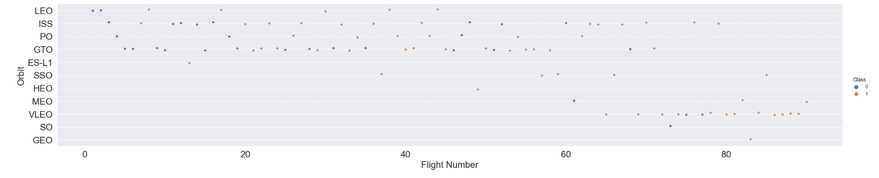
Flights Number v Orbit Type
Inferences (Note; blue=failed launch and orange=successful launch):
We have observed a notable correlation between the success rate and the number of flights for satellites in
the Low Earth Orbit (LEO). This suggests that an increase in the number of flights in LEO orbit positively
influences the success rate.
However, when examining satellites in the Geostationary Transfer Orbit (GTO), we did not find any
significant relationship between the flight number and the success rate. It seems that the number of
Flights does not play a significant role in determining the success rate for satellites in GTO orbit.

Slide 23
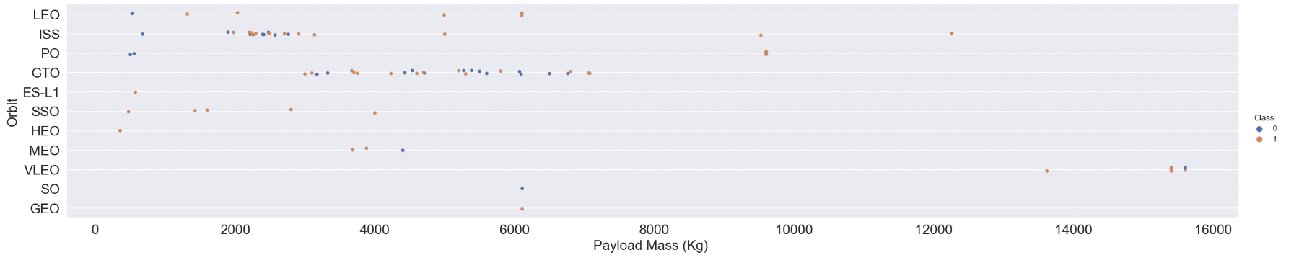
Payload Mass v Orbit Type
Inferences (Note; blue=failed launch and orange=successful launch):
Our analysis indicates that the weight of payloads plays a significant role in determining the outcome of launches. Specifically, in LEO, ISS and PO we have observed a positive correlation between heavier payloads and improved success rates. This suggests that increasing the weight of payloads in LEO, ISS and PO orbit tends to enhance the likelihood of a successful launch.
Conversely, when considering the Geostationary Transfer Orbit (GTO), we have uncovered a mixed trend. GTO orbit seems to depict no correlation between payload and success rate.
Finally, SO, GEO and HEO orbit requires more data points to make inferences/ observe trends.

Slide 24
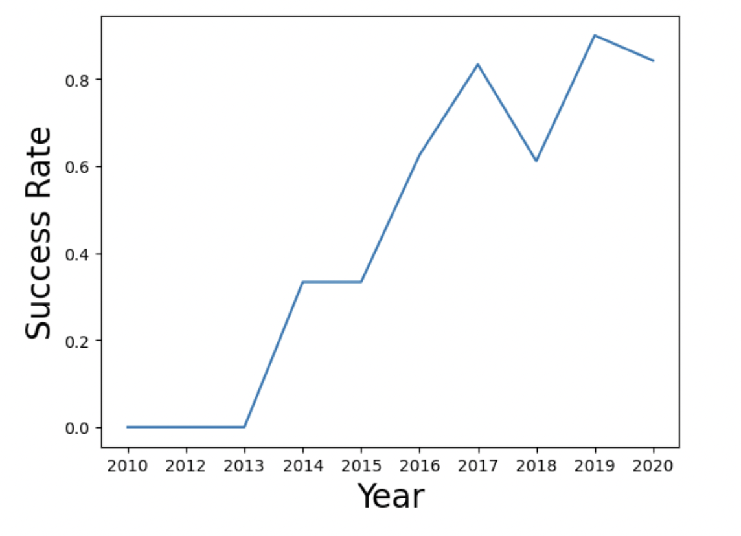
Launch Success Yearly Trend
Inferences:
Inferences:
The success rate improved from 2013 to 2017 and from 2018 to 2019
However, the success rate deteriorated from 2017 to 2018 and from 2019 to 2020
Overall, the SpaceX rocket launch success has improved, since 2013.

Slide 25
EDA with SQL

Slide 26
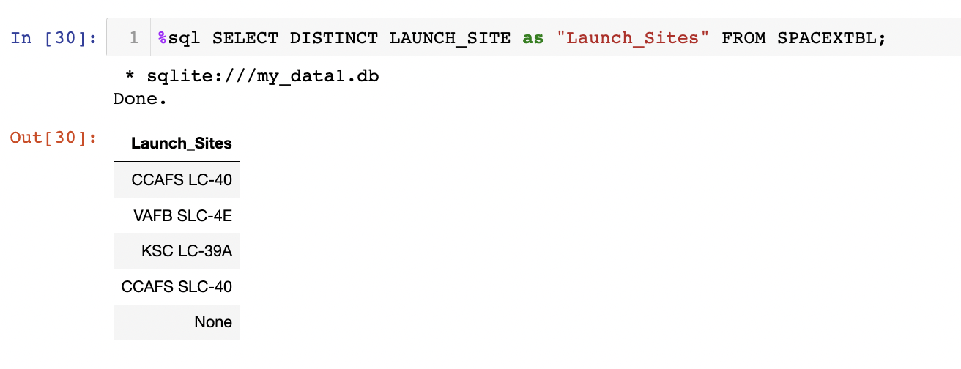
All Launch Site Names
SQL Query and Results:
Overview:
Displays the names of unique launch sites, in the space mission

Slide 27
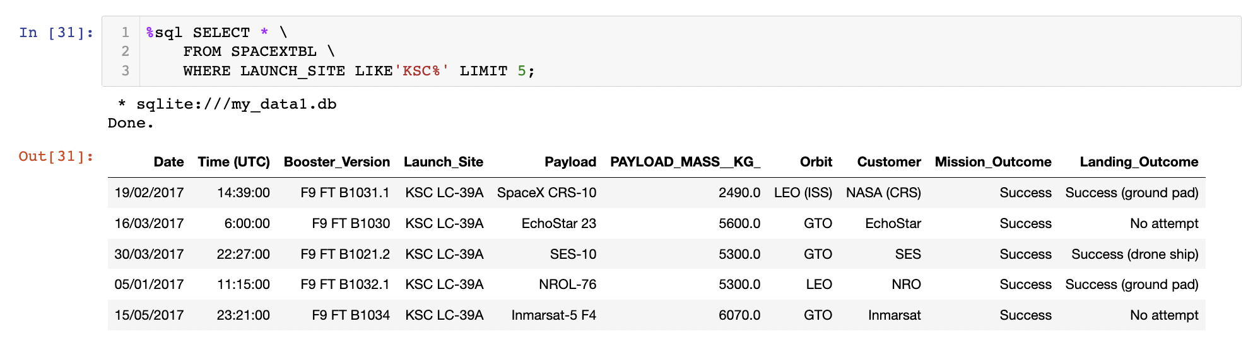
Launch Site Begins With ‘KSC’
SQL Query and Results:
Overview:
Displays 5 records where launch sites begin with the string, ‘KSC’ (Kennedy Space Center)

Slide 28
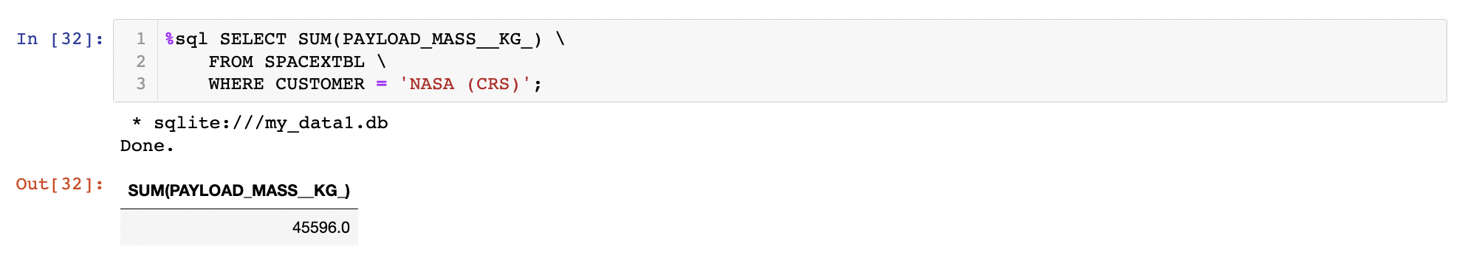
Total Payload Mass
SQL Query and Results:
Overview:
Displays the total payload mass carried by boosters, launched by NASA (CRS/ Commercial Resupply
Services)

Slide 29
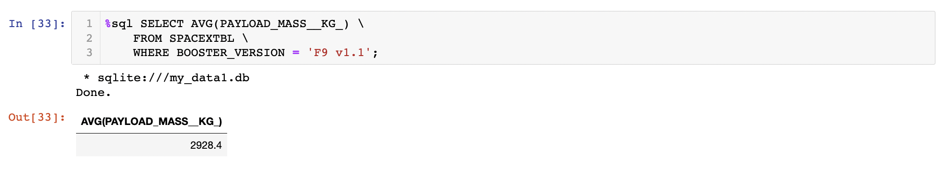
Average Payload Mass by F9 v1.1
SQL Query and Results:
Overview:
Displays average payload mass carried by booster version F9 v1.1

Slide 30
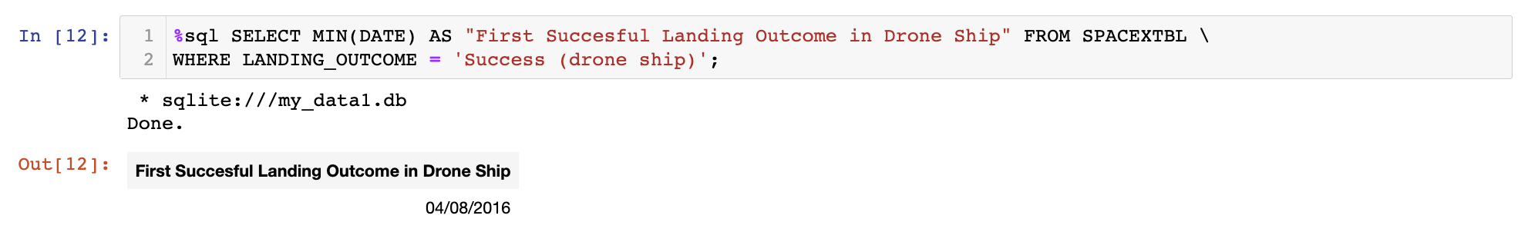
First Successful Drone Ship Date
SQL Query and Results:
Overview:
Lists the date when the first successful landing outcome for a drone ship was achieved

Slide 31
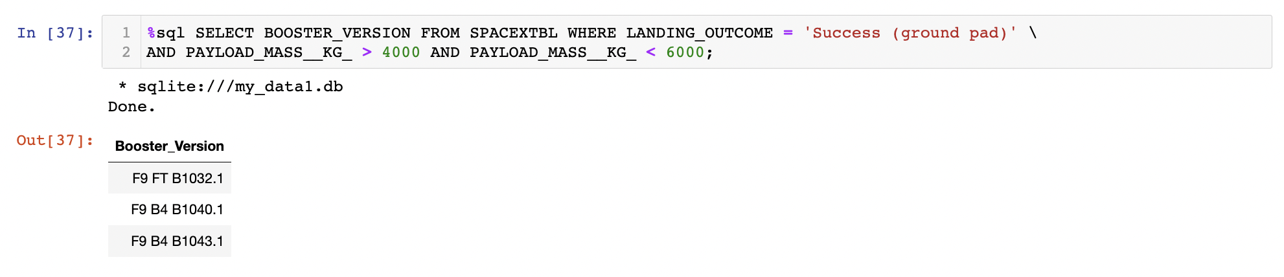
Successful Ground Pad Landing With Payload Between 4000 and 6000kg
SQL Query and Results:
Overview:
Lists the names of all boosters that had success in ground pad landings, with payload between 4000 and
6000kg.

Slide 32
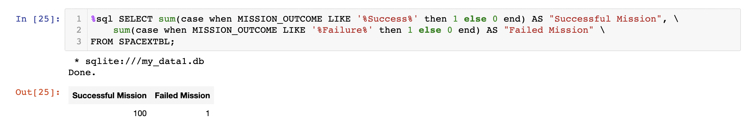
Total Number of Successful and Failed Mission Outcomes
SQL Query and Results:
Overview:
Lists the total number of successful and failed mission outcomes

Slide 33
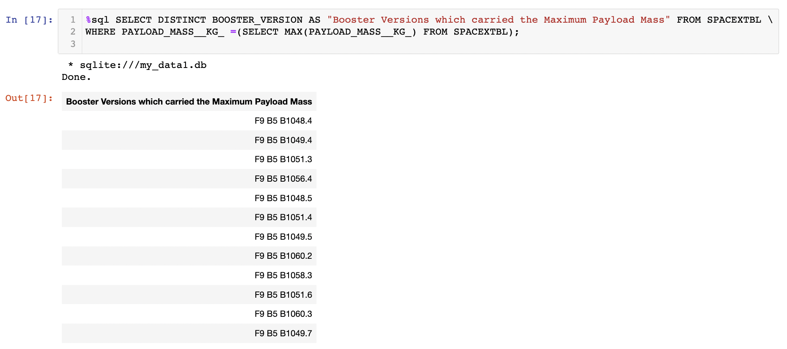
Boosters That Carried Maximum Payload Mass
SQL Query and Results:
Overview:
Lists the names of the booster versions that carried the maximum payload mass

Slide 34
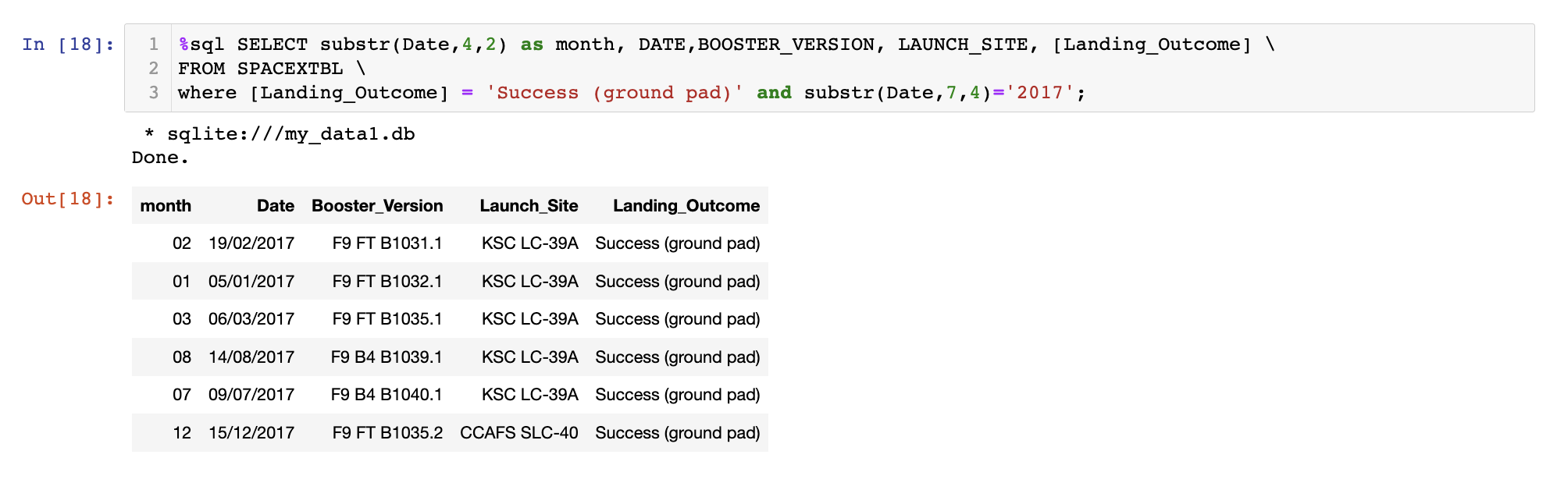
2017 Launch Records
SQL Query and Results:
Overview:
Lists the successful landing outcomes for ground pad, their booster versions and launch site names for all months in year, 2017.

Slide 35
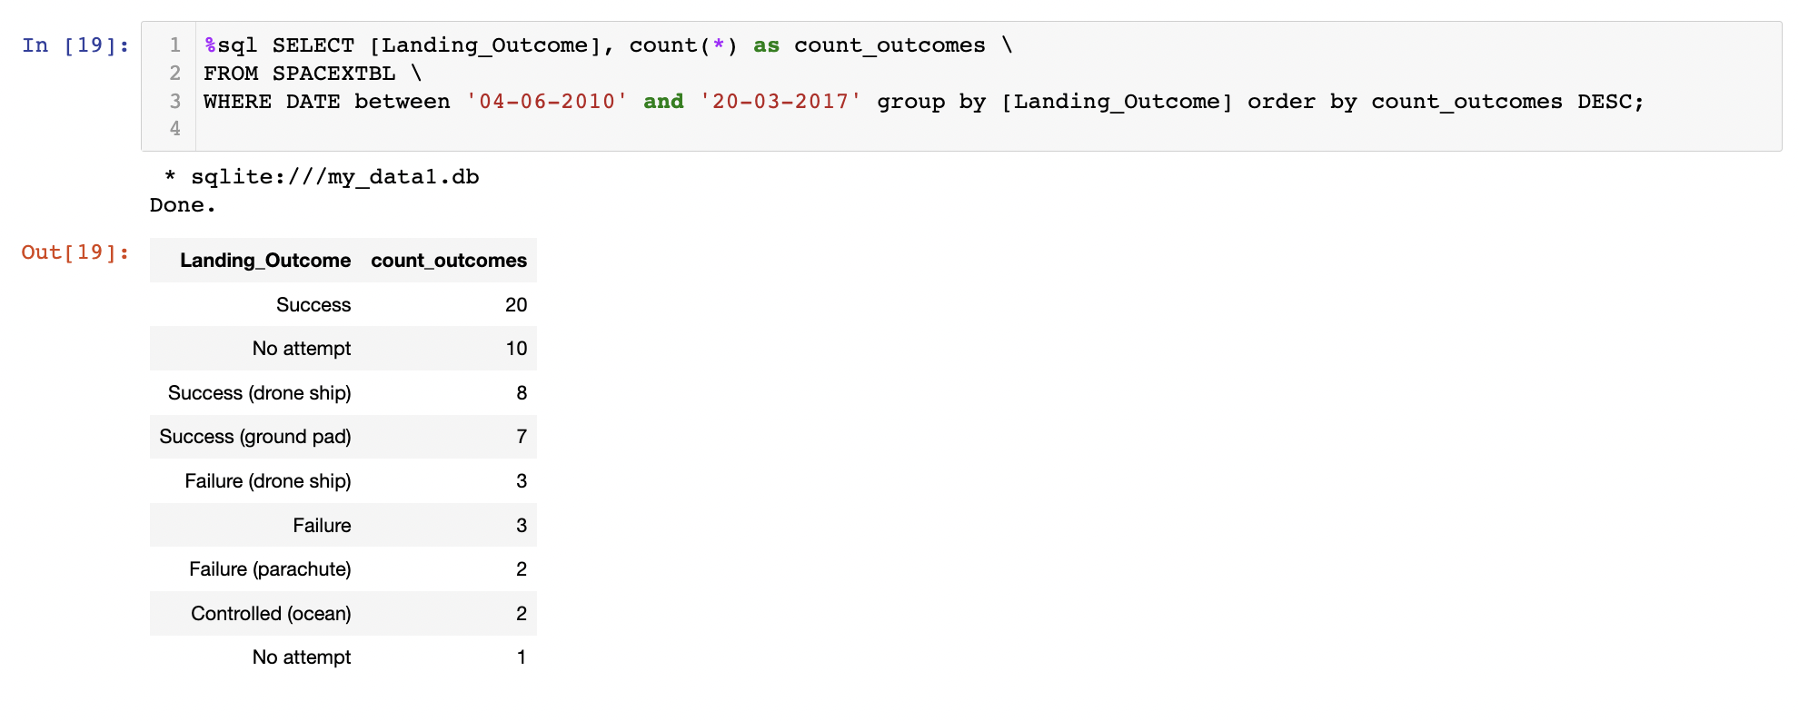
Rank the Count of Successful Landing Outcomes Between 04/06/10 to 20/03/17
SQL Query and Results:
Overview:
Ranks the count of landing outcomes between dates, 04/06/10 to 20/03/17, in descending order

Slide 36
Launch Site Location Analysis
Interactive Map with Folium

Slide 37
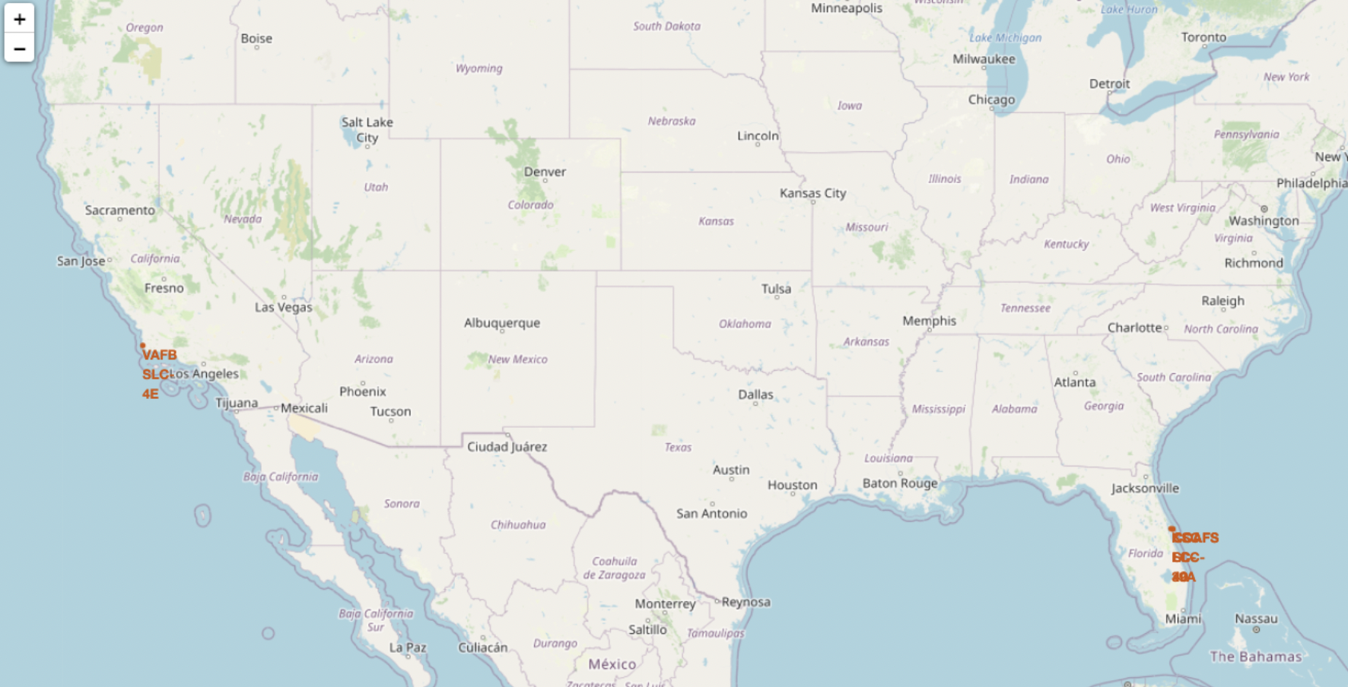
Launch Sites (with Markers)
Equator:
Most of the launch sites are in proximity to the equator line. The closer the launch site to the equator, the
easier it is to launch to equatorial orbit. Also, if a spacecraft is launched from a site near Earth's equator, it can
take optimum advantage of the Earth's substantial rotational speed. Sitting on the launch pad near the equator,
it is already moving at a speed of over 1650 km per hour relative to Earth's centre [2]. This naturally helps
save costs towards extra fuel and boosters.
Coast:
Reviewing the interactive map, all launch sites are in very close proximity to the coast. If
anything goes wrong during their launch, the debris would essentially fall into the ocean, which acts
as a safety measure i.e. far away from densely populated areas.

Slide 38
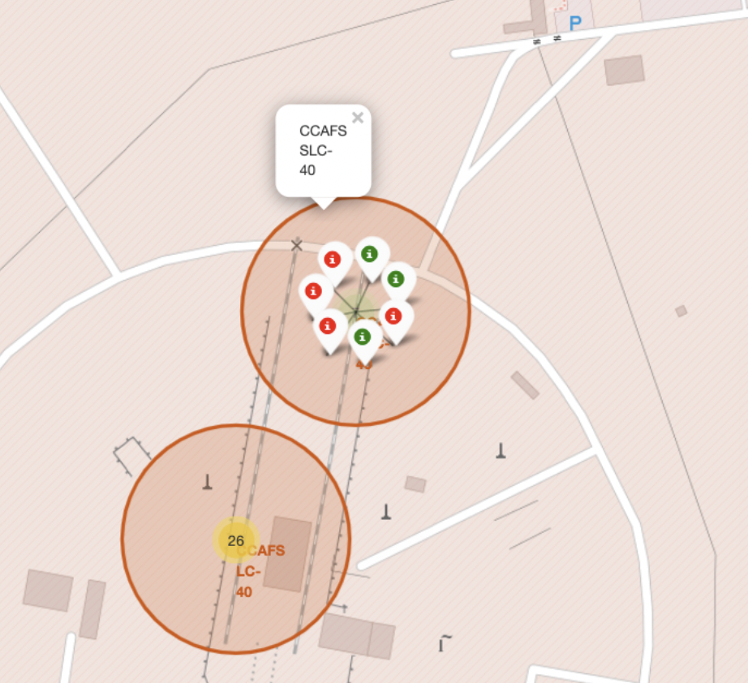
Launch Outcomes for Each Site
From the color labeled markers above, we can identify which launch sites have a high success rate.
Green Marker = successful launches
Red Marker = unsuccessful launches
Launch site CCAFS SLC-40 has a 3/7 (43%) success rate (refer to pop up above)

Slide 39
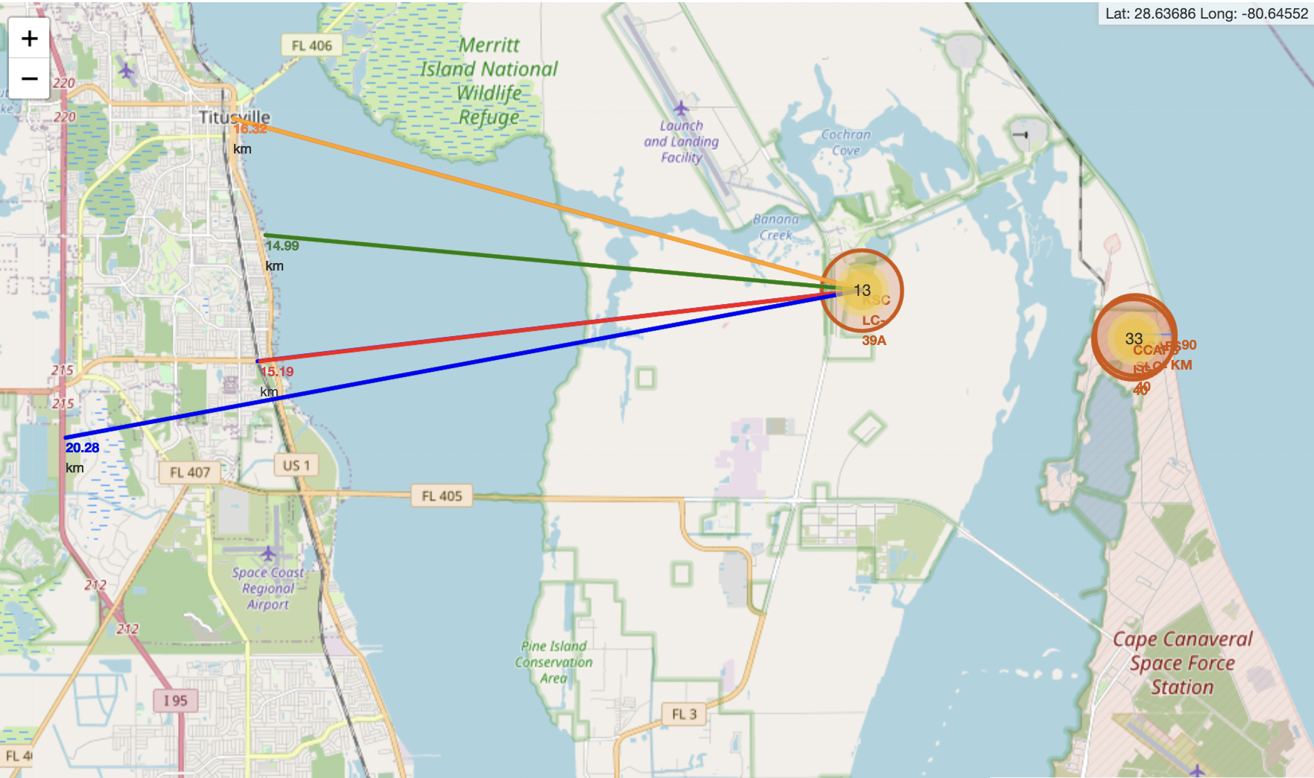
Distance from Launch Site to Proximity
If we take launch site 13 from the map above (KSC-LC-39A), we can make some inferences:
Launch site is in close proximity of railway i.e. 15.19km
Launch site is in close proximity to the highways i.e. 20.28km
Launch site is in close proximity to the coastline i.e. 14.99km
Launch site is in close proximity to Titusville (closest city on map) i.e.16.32km
A failed rocket launch could potentially be dangerous to these points of interest above. Risk
assessment should then be carried out with each launch site, for precaution.

Slide 40
Build a Dashboard (App) With Plotly Dash

Slide 41
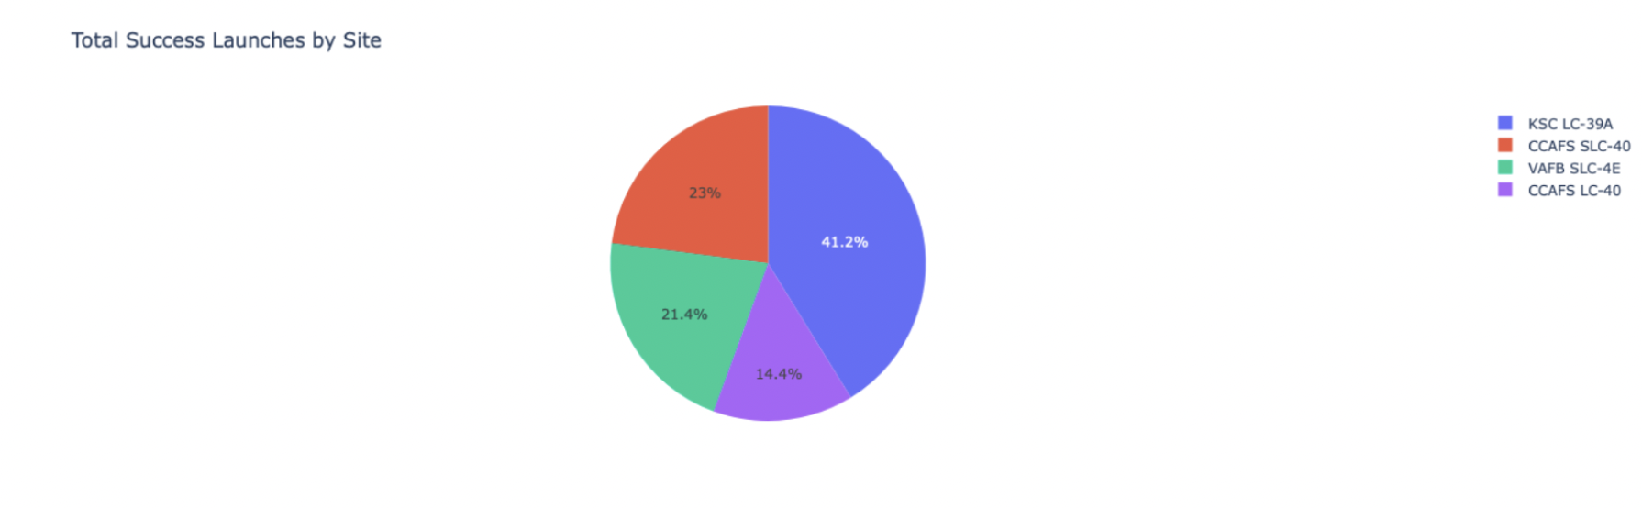
Launch Success Count for All Sites
Inferences:
From the pie chart, it can be clearly seen that KSC LC-39A has the most successful launches (41.2%),
amongst other launch sites

Slide 42
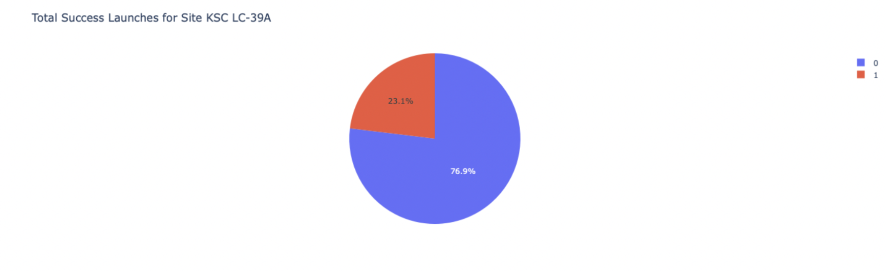
Launch Site with Highest Launch Success Ratio
Inferences:
KSC LC-39A also has the highest launch success rate (76.9%), amongst other launch sites.
10 successful launches and 3 failed launches

Slide 43
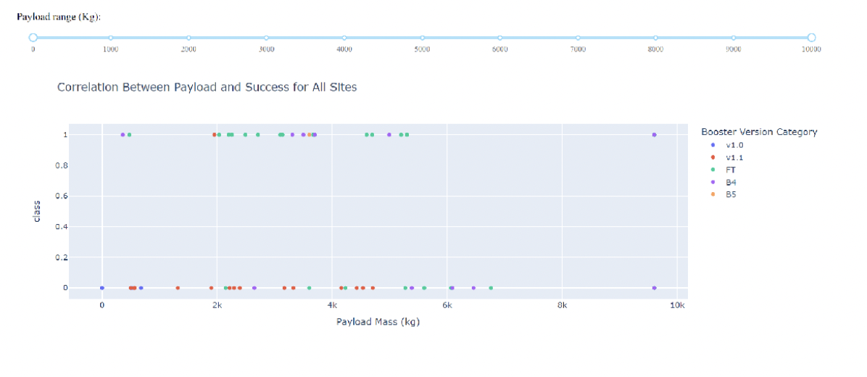
Payload Mass v Launch Outcome for All Sites
Inferences:
The chart indicates that payload mass between 2000kg and 5500kg have the highest success rate

Slide 44
Predictive Analytics (Binary Classification)

Slide 45
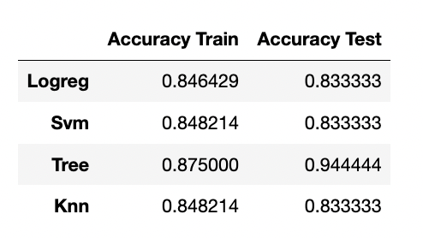
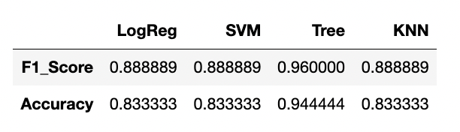
Evaluation
All models produced the same test accuracy, apart from the decision tree (DT) model. Indicating that they perform
reasonably well in terms of predictive accuracy on the test/ unseen data. We can also consider other evaluation metrics or
criteria to determine the best model i.e. F1 Score, as opposed to test accuracy:
We can clearly see the best performance is a F1 Score of 0.96, from the Decision Tree. F1 score is usually more useful than
accuracy, especially if we have an uneven class distribution. Accuracy works best if false positives and false negatives have
similar cost. However, if the cost of false positives and false negatives are different (such as our case, refer to confusion
Matrices on slide 47) it's better to look at both Precision and Recall.
Interpretability: We can consider the interpretability of the models. Some models, such as decision trees or
linear models, provide more interpretable results compared to complex models like neural networks or
ensemble methods. In our case, the Logistic Regression and Decision tree are considered interpretable,
unlike SVM and KNN. And the higher the interpretability of a machine learning model, the easier it is for
someone to comprehend why certain decisions or predictions have been made.

Slide 46
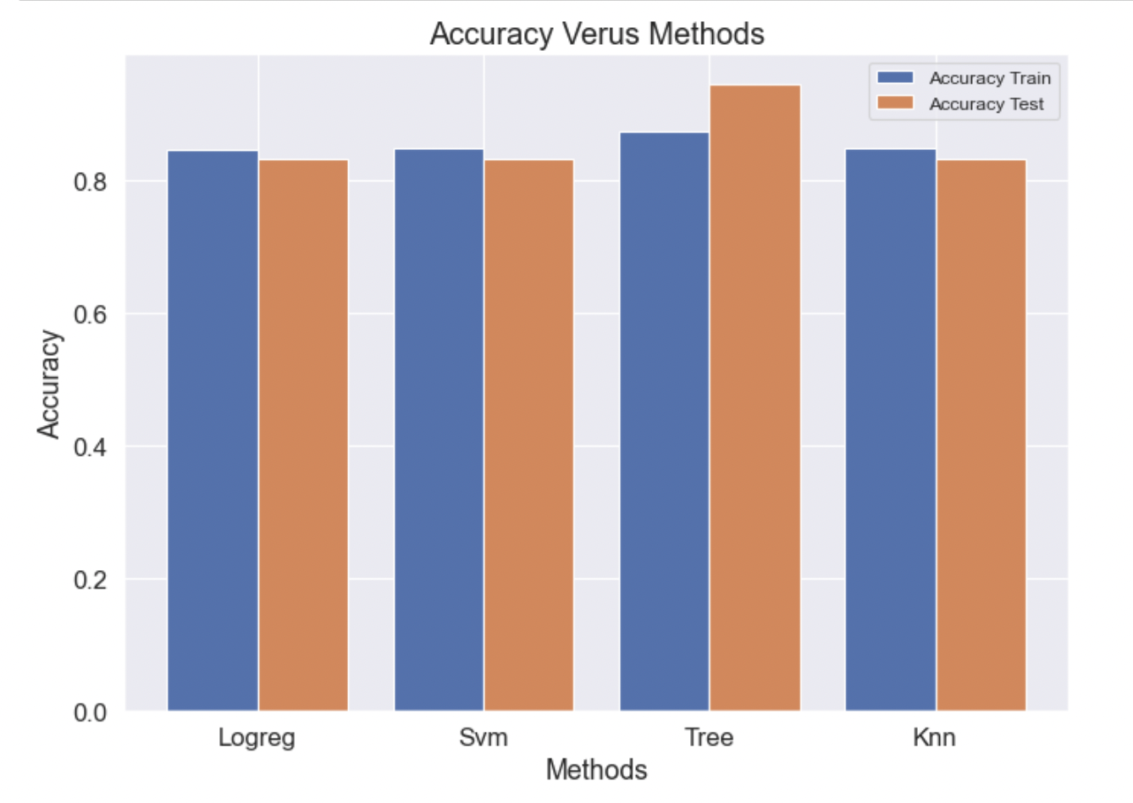
Evaluation (Cont.)
Data: In general we lack test data, as we only have 18 test samples to work with. Hence, the test
dataset is an unrepresentative sample of data from the domain. Possibly a reason why all the test
accuracies are similar (apart from the DT model). Overall, the evaluation metrics and criteria may vary
depending on our specific problem, data, and objectives of our project. Therefore, it is recommended to
consider a combination of metrics and criteria to make an informed decision about the best
model, taking into account our specific requirements and constraints. In our case, the DT method/ model
performs the best, when we take into consideration all evaluation metrics or criteria.

Slide 47
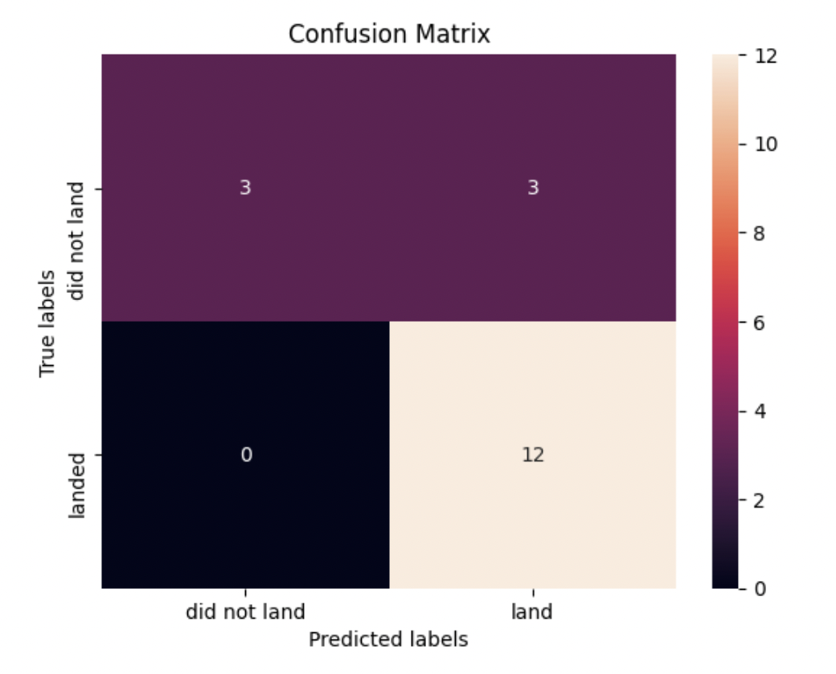
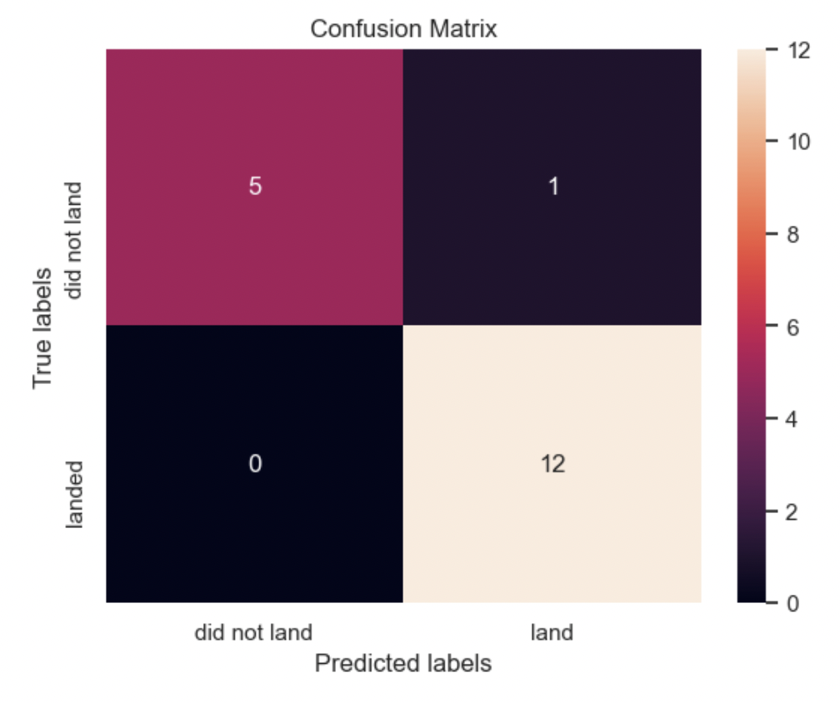
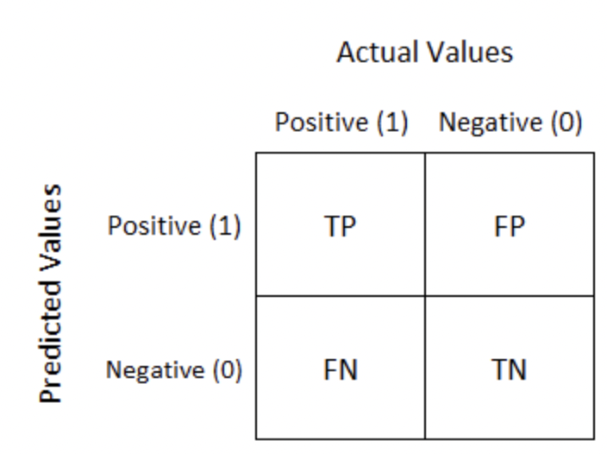
Evaluation (Cont.) – Confusion Matrix
In the context of predicting a successful landing, false positives (FP) refer to cases where the model predicts a
successful landing when it actually resulted in a crash or failure. Having 3 false positives (all models, except
the DT with only 1 FP) is a major problem in this scenario because it can lead to false confidence in the
model's predictions, potentially putting human lives at risk.
Consider a situation where the model predicts a successful landing, but in reality, the landing is
unsuccessful. If these false positives are not caught and appropriate precautions are not taken, the
consequences could be catastrophic. For example, if the rocket is deemed safe to land based on
the model's prediction but is actually not in a suitable condition, it could result in a crash.

Slide 48
Evaluation (Cont.)
To ensure the safety and reliability of the landing process, it is crucial to minimize false positives. The DT model
performed best here, where it only produced 1 FP. The model should be highly accurate in identifying actual
successful landings to avoid any erroneous decisions or actions based on incorrect predictions. Therefore,
false positives are a major problem because they can compromise safety and undermine the trustworthiness of
the predictive model.
Finally, here are some strategies that could reduce the FP occurrence and mitigate their impact:
Gathering more training data: Increasing the quantity and diversity of training data can help the model learn
better decision boundaries, potentially reducing false positives. Ensure that the training data includes a
representative distribution of both positive and negative instances.
Ensemble methods: Employing ensemble methods, such as bagging or boosting, can help reduce false
positives by combining multiple models' predictions. Ensemble methods often result in more robust and
accurate predictions than a single model.
Feature engineering: Carefully selecting and engineering features can improve the model's ability to
discriminate between positive and negative instances. Consider incorporating additional relevant features
that capture meaningful information for the problem at hand.
Using different evaluation metrics: Accuracy alone might not be an appropriate metric when
dealing with imbalanced datasets. Consider using evaluation metrics that are more sensitive to
false positives, such as precision, recall, F1 score, or area under the precision-recall curve.

Slide 49
Conclusion
The decision tree is the best model/ algorithm for this particular dataset
Most launch sites are near the equator, for an additional natural boost [2]. Which saves costs on extra fuel
and boosters
The success rate of launches increases over the years
Launches with a low payload mass show better results than launches with a larger payload mass
KSC-LC39A has the highest success rate of all launches, amongst all launch sites
Orbits ES-L1, GEO, HEO, and SSO have 100% success rate

Slide 50




Appendix
References
[1] SpaceX Wiki
https://en.wikipedia.org/wiki/SpaceX
[2] Basics of Space Flight/ Launch
https://solarsystem.nasa.gov/basics/chapter14-1/#:~:text=If%20a%20spacecraft%20is%20launched,hour%20relative%20to%20Earth's%20center.

